Slide 1
Using AI to Enhance your Personal Wellness
Beth Wolfset
Senior Data Architect, Insight Enterprises
https://github.com/BSWolfset/PresentationSlidedecks

Slide 2


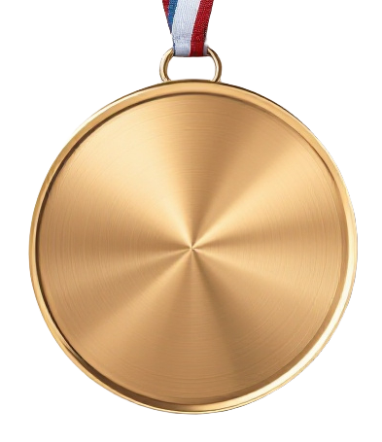

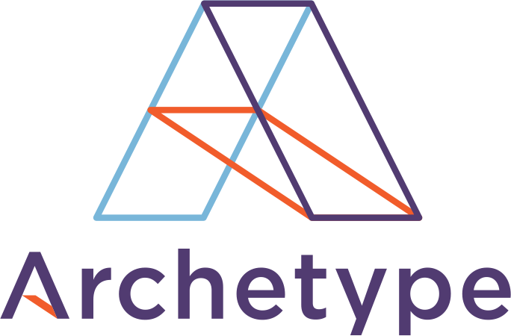


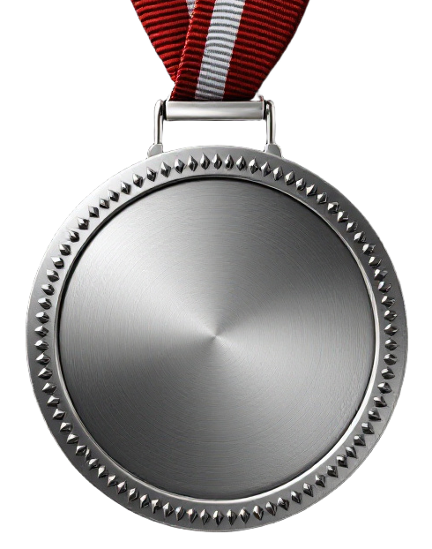





Boston Code Camp Thanks to our Sponsors!
Gold
Silver
In Kind
Hosting Sponsor

Slide 3
Agenda
Disclaimers & Introduction
Definitions
Audience Experience
AI Enabled Apps
Personality
AI and Mental Health
Ask AI
Use Case 1: Chat GPT Pro
Use Case 2: Build the Knowledge
Use Case 3: Adding in Tracking Data
Recommendations
Resources
Notes:
Leverage AI for a Healthy Lifestyle – May 29 Marissa Strayer

Slide 4
Disclaimers & Introduction
I AM NOT:
Doctor, PA, or Nurse
Psychiatrist, Psychologist, or Therapist
Nutritionist or Dietician
Physical or Occupational Therapist
AND NEITHER IS AI
Nothing presented here should be construed as medical advice
I AM:
Data Architect with 35+ years of experience
Mother and Grandmother
Friend and Colleague
Woman in her goddess years
Human living her best life

Slide 5
Definitions - Wellness
Definition of Wellness
Holistic integration of physical, mental, and spiritual well being, fueling the body, engaging the mind, nurturing the spirit. It is more than physical health (nutrition, exercise and weight management).
Active pursuit of optimal physical, emotional, social and spiritual health
Active pursuit of activities, choices and lifestyles tat lead to a state of holistic health
Focus on conventional, Holistic and natural approaches to self-healing and preventative care
Examples:
Mindful Eating and Balanced Nutrition
Daily Movement
Stress reduction, Breathwork
Quality Sleep
Daily Meditation, Spiritual, Prayer
Gratitude Practices or Reflection
Supplements and Oils
Connection to Nature
Social Connections
Detox
Art, Music, Creative Writing
Volunteering
Notes:
BioHacking definitions come from a variety of sources including Cleveland Clinic, WebMd, Prevention, Mirriam- Webster
Wellness definitions come from a variety of sources including NIH, Mayo Clinic, Cleveland Clinic, Wellness.com

Slide 6
Definitions - Biohacking
Definition of Biohacking
DIY hacks to self-care that uses everything from lifestyle changes to high-tech tools and science to improve your health and live longer.
Using your body as an experiment to hack your health for longevity
Making changes or hacks to your body or lifestyle to improve your health, brainpower, or athletic ability
biological experimentation (as by gene editing or the use of drugs or implants) done to improve the qualities or capabilities of living organisms especially by individuals and groups working outside a traditional medical or scientific research environment, often done on one’s own body
Examples:
Diet, intermittent fasting
Sleep Tracking
Exercise Monitoring
Supplements
Gene Editing
Neurostimulation
Hormone Regulation
Devices:
Tracking nutrition, hydration, exercise
Labs
Smart watches
CGM
HRV sensors
Notes:
BioHacking definitions come from a variety of sources including Cleveland Clinic, WebMd, Prevention, Mirriam- Webster
Wellness definitions come from a variety of sources including NIH, Mayo Clinic, Cleveland Clinic, Wellness.com

Slide 7
Audience Experience
Nutrition:
Diet: Keto, Whole Foods, Plant Based, Vegetarian, Vegan
Cadence: Intermittent Fasting, Do not eat after
Tracking: My Fitness Pal, LiveStrong, Weight Watchers
Exercise:
Program: Gym, Personal Trainer, Online
Cadence: Daily, Rotation
Tracking: Smartwatch, FitBit, Garmin, WHOOP
Medical Monitoring:
Types: Weight, Blood Pressure, Pulse, Glucose, Heart Rate, Blood Thinner
Cadence: Daily, Multi Daily
Tracking: Smartwatch, SmartPhone, App
Devices: Scale, CGM, Glucometer, Pulse Oximeter, BP Cuff, Kardiamobile
Sleep:
Cadence: Whenever tired, same time each night
Tracking: Smartwatch, Bed
Devices: CPAP, Inspire
Stress or Meditation or Prayer:
Program: Individual, Organized
Cadence: time each day or week
Tracking: App, Calm, Breathe, StressScan
Devices: SmartWatch, Oura ring

Slide 8
AI Enabled Apps
Nutrition
Alma
Foodvisor
HealthifyMe
Lose It!
Lumen
MyFitnessPal
Nourish
Simple
SnapCalorie
Zero
Yuca
Fitness
EvolveAI
Fitbit
Fitbod
FitnessAI
Freeletics
HealthifyMe
JuggernautAI
MyFitnessPal
Nike Training Club
Planfit
Strava
Sworkit
Mental Wellbeing
Ada Health
Betterhelp
Breathe+
Breathwrk
Ginger
Headspace
Mentat AI
Woebot
Wysa
Notes:
The New Personalized AI Nutritionist - The Decision Lab
42+ Best AI Health Apps for Your Smart Wellness in 2025

Slide 9
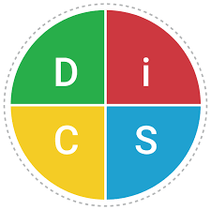
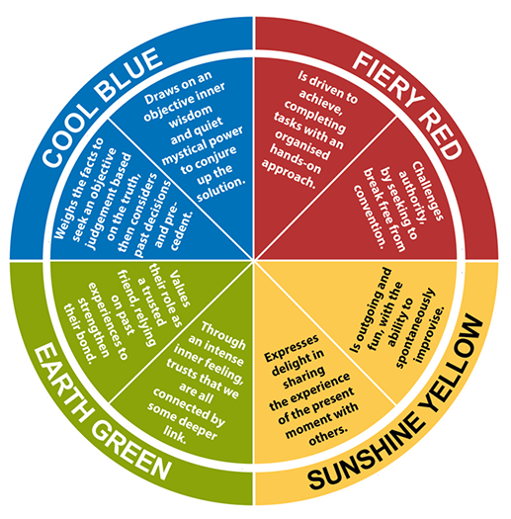
Personality Types
People have different personalities
Personality Types:
Director (A)
Socializer (B)
Thinker (C)
Supporter (D)
DISC:
Dominance
Influence
Steadiness
Conscientiousness
Big Five Model:
Extraversion
Agreeableness
Conscientiousness
Neuroticism
Openness to experience
Insights Discovery:
Red (assertive, results-driven)
Yellow (outgoing, enthusiastic)
Green (calm, empathetic)
Blue (logical, precise).
AI Presented as a Personality
Movies:
WALL-E
Her
Ex Machina
Blade Runner
The Terminator
Smart House
Television:
Knight Rider
Westworld
Person of Interest
Humans
AI ‘Personality’ Traits
Non-judgmental
Impulsive
Insecure
Know-it-All
Anonymous?
Intelligent?
Can you change the personality of the AI with the prompt?

Slide 10
Does the AI Tool matter?
AI LLMs are trained for specific outcomes
Image generation or editing
Text generation or editing
General knowledge
General Knowledge
Chat GPT
Google Gemeni - will remind you it is not a doctor or qualified health professional
Microsoft CoPilot
Claude by Anthropic

Slide 11
AI and Mental Wellbeing
Stress
Help with organizing or goal setting
Help with breathing exercises
Coping Strategies
Help create responses for difficult people or situations
Religion, Spiritual, or Prayer
Lead through process
Provide regular quotes or prayer
Social & Volunteer
Introduce new ideas and venues
Provide ways to connect
Simulate friends and family : Elderly, Stuck in House, Depressed
Mental Health
Help with journaling
Provide additional education
May be integrated with Telehealth solutions
DO NOT use a substitute for therapy
Notes:
She built herself an AI family on ChatGPT. It can get complicated.
The Do’s & Don’ts of Using ChatGPT as Your AI therapist | Lisa Chen & Associates Therapy

Slide 12
Ask AI
Meal Planning
“Plan 5 days of dinners that are vegetarian and low-carb”.
“Create a weekly meal plan that supports stable blood sugar levels with high-fiber foods.”
“Create a 5 day meal plan that allows meal-prep on Sunday”
“Create a 7-day fat loss meal play using a 500-calorie deficit prioritizing high satiety foods and 80g of protein per day.”
“Act as a certified nutritionist and evaluate daily diet for the past week. Provide insights and suggest improvements.” <upload meals from tracking app>.
Fitness Goals
“Design a four-week strength training plan for beginners using only dumbbells.”
“Create a 20-minute home workout that includes core stability and low-impact cardio.”
“Build me a progressive running plan to train for a 5K over twelve weeks.”
“Revise my weekly plan to include more rest and fewer high-intensity workouts.”
“Design a progressive resistance workout for 3 days per week, targeting full-body hypertrophy. Include rest times, rep ranges and indicators of muscle failure.”
Stress Management
“Guide me through a five-minute breathing exercise to reduce anxiety.”
“Give me daily check-in questions to track my mood and energy.”
“Create a short journal prompt to help me reflect on my emotions each day. Schedule it to prompt me at 7pm”
“Give me a 5-minute daily mental wellness routine I can do before work to reduce anxiety.”
Notes:
20 Super-Effective AI Prompts for Health - alive magazine

Slide 13
Ask AI
Sleep Improvement
“Help me build a 45-minute bedtime routine that reduces screen time and promotes relaxation.”
“List five changes I can make during the day to improve my deep sleep.”
“Create a week-long sleep journal template I can use to track my bedtime, wake time, and caffeine consumption.”
Make a Schedule
“Create a daily schedule that includes 30 minutes of movement, three balanced meals, and 1 hour in the evening to be with my children”
“My morning routine isn’t helping me feel energized. What should I change?”
Monitor Symptoms/Health
“Create a weekly tracker to log my headaches, sleep, hydration and caffeine.”
“Summarize the last 60 days of my symptoms for a conversation with my clinician.”
Financial
“Analyze my spending for the past month and provide a budget that cuts costs and allows me to save $200”
“Track my recurring bills and subscriptions, flag any unnecessary ones and recommend actions to save money”.
“Evaluate my debts and recommend an efficient repayment strategy.”

Slide 14
Use Case 1: Chat GPT Pro
Female Colleague’s Wellness Journey
Problem: Struggling with weight and all the consultants (in Netherlands) here with their online degrees were not helping.
Goals: Understand the balance between necessary intake for staying healthy, and balancing that with hormones and weight.
Methodology:
Took blood test results and some other information
Created a file
Prompted AI for baseline stats of what health looked like for her age / size etc,
Merged those together with known "issues" to get a holistic picture about what food to use, what to avoid, and impact
Recommendation: a Keto diet with low carbohydrate, near-zero lactose, high protein and fat
Result: Able to lose some weight

Slide 15
Use Case 2: Build the Knowledge
Tested using Gemini and Microsoft CoPilot and Insight version of ChatGPT
Used the same prompts in all
Basic info from June (easy to get from Patient Portal). Gender, age, weight, diet, anecdotal exercise, medications, HbA1c, Cholesterol, BP, Pulse.
Gemini summarized the data, suggested I might want to talk to a dietician, discuss my meds with my doctor, do a better job watching after meal glucose. Offered to find peer-reviewed information on adjusting diet.
CoPilot summarized the data, talked about interactions with my medication, complimented me on diet and exercise, recommended I continue my HIIT workouts, at 2-3 sessions of strength training a week, increase steps to 10,000 and try to reduce my weight 15 lbs over the next 6-9 months. Offered to generate meal and/or exercise plan and glucose management tips.
ChatGPT summarized the data, highlighted good and bad levels and discussed interactions between systems, continue workouts and add 2-3 sessions of strength training per week, increase steps to 10,000. Set goal of losing 10-15 lbs over next 3-6 months.
Added information from October
Gemini congratulated me on my progress. Connected to my Patient and recognized additional bloodwork was done – but I had to feed in the results. Offered to discuss strategies for maintaining this momentum.
CoPilot congratulated me on my progress. Suggested keeping adequate protein and watching for hidden carbs. Reiterated to add strength training. Offered to create a dashboard summary of my metrics and design a weekly plan.
ChatGPT congratulated me on my progress, suggested CGM, losing another 2-12 lbs, add resistance workouts, redo labs in Jan.

Slide 16
Use Case 3: Add in the tracking data
Download data from Apple Watch – using Health Auto Export
A Lot of files: Active Energy, Heart Rate, Heart Rate Recovery, Resting Energy, Step Count, Distance
HealthAutoExport-<date range>.csv
Workouts-<date range>.csv
Download data Stelo CGM – using clarity.Dexcom.com
CGM_DailyStatistics_2025-11-15_164540.pdf
Upload files to Copilot - Summarize data and paste into Gemini
Ask additional Prompts
Notes:
How To Use AI To Optimize Your Health: A Step-By-Step Guide – Conscious City Guide
Identify any concerning patterns or trends
Point out areas showing improvement
Highlight any areas of decline
Note any interesting correlations between different health metrics
Create graphs showing the trends in my key biomarkers over time
Analyze the effectiveness of my current treatments
Suggest specific optimizations for my:
Supplement protocol
Diet
Exercise routine
Most Effective Treatments

Slide 17
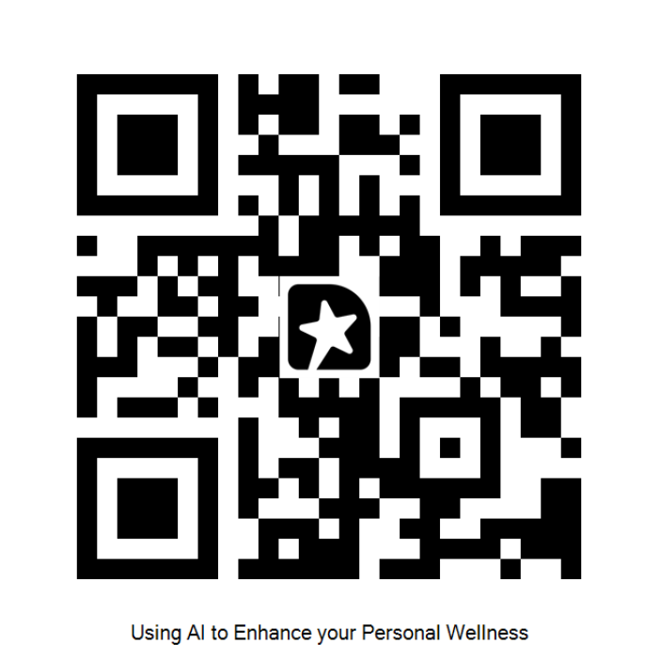
AI Recommendations
AI Recommended for me
Watch evening meal composition and post meal glucose spikes. Make dinner lighter in carbs – eat whole grains and minimize refined carbs.
Consider Omega-3 supplement or regularly eat flaxseed/chia seed
Consider a probiotic (I cannot take them)
Consider Magnesium Glycinate – good for muscles and can promote deep sleep
Improve deep sleep – asked for more ideas to improve (Gemini & CoPilot)
Continue to lose weight
Add in 2-3 sessions strength or resistance training per week (asked for workout). Also increase intensity of 3-4 sessions existing workouts
Add stretching or yoga sessions to support joint health
Recommendations and Next Steps
Results likely similar across tools. Pick one.
Start with easy information
Build the chat
Update with new results periodically
Add in summarized tracking data
Pick 1 or 2 recommendations to work on

Slide 18
References
Articles Used When Compiling This Presentation
20 Super-Effective AI Prompts for Health 20 Super-Effective AI Prompts for Health - alive magazine
Top 20 AI Prompts for Personal Finance Top 20 AI Prompts for Personal Finance (Copy/Paste Ready) –
17 Top ChatGPT Prompts for Personal Finance 17 Top ChatGPT Prompts for Personal Finance [UPDATED]
How to use AI to optimize your health https://consciouscityguide.com/how-to-use-ai-to-be-your-health-expert/
How AI is Transforming Fitness Apps https://www.healthandfitness.org/improve-your-club/how-ai-is-transforming-fitness-apps/#
Biohacking meets AI: Digital tools to track and enhance vitality https://worldhealth.net/news/biohacking-meets-ai-digital-tools/#:~:text=The%20modern%20biohacker's%20toolkit%20is,can%20deliver%20insights%20in%20seconds.
AI for Health – Benefits of AI in Healthcare https://www.sbm.org/healthy-living/ai-for-health-benefits-of-ai-in-healthcare
7 Ways You Can Use ChatGPT for Your Mental Health and Wellness 7 Ways You Can Use ChatGPT for Your Mental Health and Wellness
She built herself an AI family on ChatGPT She built herself an AI family on ChatGPT. It can get complicated.
The Do’s & Don’ts of Using ChatGPT as Your AI Therapist The Do’s & Don’ts of Using ChatGPT as Your AI therapist | Lisa Chen & Associates Therapy
The New Personalized AI Nutritionist The New Personalized AI Nutritionist - The Decision Lab
42+ Best AI Health Apps for Your Smart Wellness in 2025 42+ Best AI Health Apps for Your Smart Wellness in 2025

Slide 19
Influencers You May Want to Look At
Plant Based or Whole Foods
Esselstyn (Caldwell, Rip, Jane)
Forks over Knives
Engine 2 Engine
Dr Neal Barnard
Joy Bauer @joybauer
Diabetes
Glucose Goddess
Mastering Diabetes
Wellness and Longevity
Peter Attia
Dr Mark Hyman
Lifespan.io

Slide 20
Thank You
beth.wolfset@insight.com
bswolfset@gmail.com
https://www.linkedin.com/in/beth-wolfset
https://github.com/BSWolfset/PresentationSlidedecks

